Slide 1

Application area of digital image processing

Slide 2
Introduction to Digital Image Processing
Digital Image Processing (DIP) is a software which is used to manipulate the digital images by the use of computer system. It is also used to enhance the images, to get some important information from it.
For example: Adobe Photoshop, MATLAB, etc.
It is also used in the conversion of signals from an image sensor into the digital images.
Digital Image Processing is a software which is used in image processing. For example: computer graphics, signals, photography, camera mechanism, pixels, etc.
Digital Image Processing provides a platform to perform various operations like image enhancing, processing of analog and digital signals, image signals, voice signals etc.
It provides images in different formats.

Slide 3
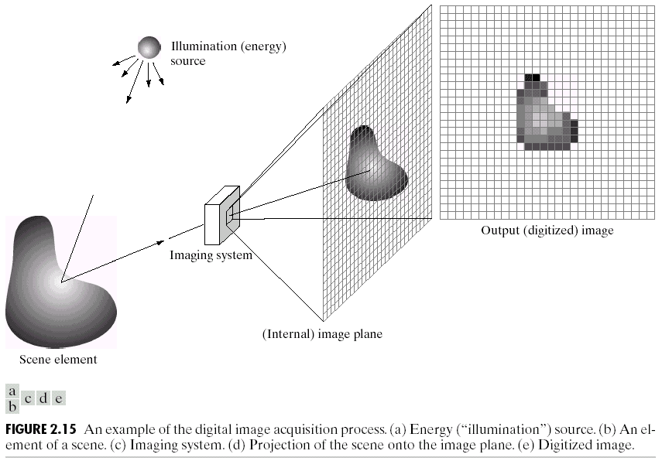
A digital image is a representation of a two-dimensional image as a finite set of digital values, called picture elements or pixels.

Slide 4
Why do we need to process an image?
1. Improvement of pictorial information for human perception
We want to enhance the quality of image so that the image will have a better look.
2. Image processing for automated machine applications
Quality control in assembly automation
3. Efficient Storage and transmission
Disk space for storing the image can be reduced
Process the image or video so that it can be transmitted over a low bandwidth communication channel

Slide 5
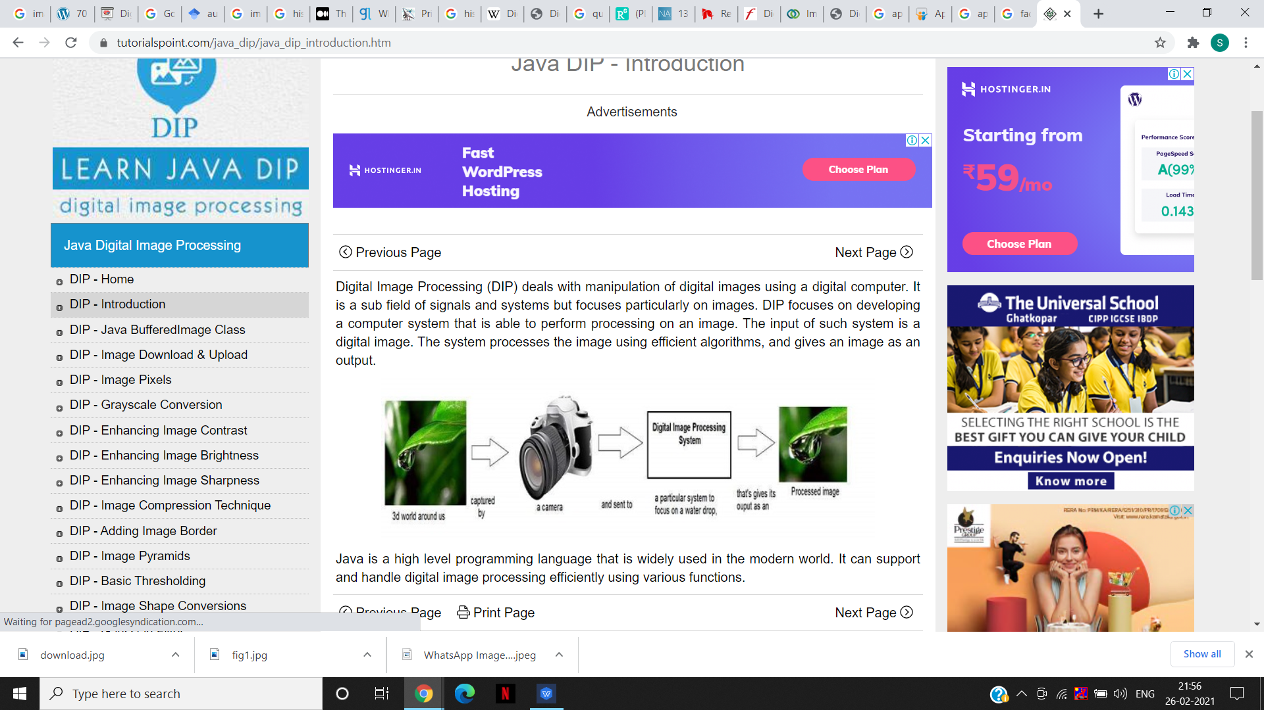
Digital Image Processing (DIP) deals with manipulation of digital images using a digital computer. It is a sub field of signals and systems but focuses particularly on images. DIP focuses on developing a computer system that is able to perform processing on an image. The input of such system is a digital image. The system processes the image using efficient algorithms, and gives an image as an output.

Slide 6
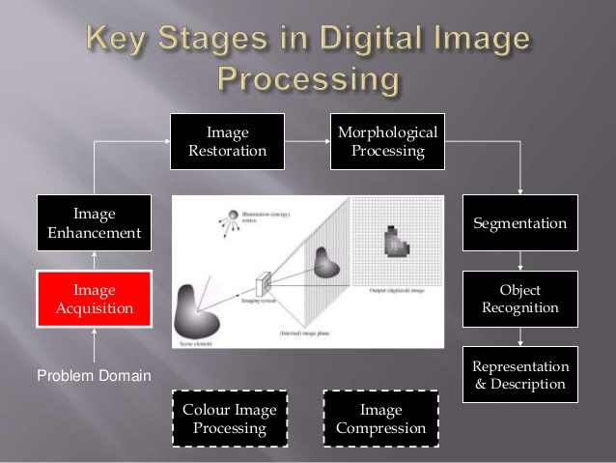

Slide 7
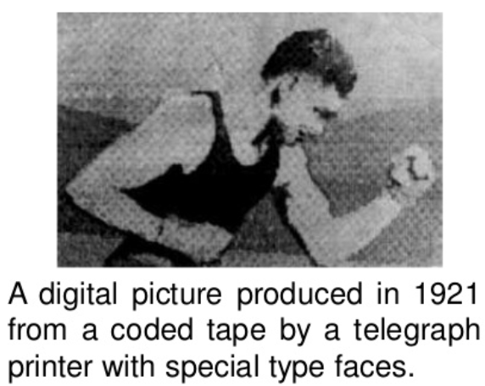
Origin of Digital Image
The first application of digital image was in the newspaper industry when the pictures were first sent by submarine cable between London and New York.
The cable picture transmission in 1921 reduced the time required to transport a picture across the Atlantic for more than a week to less than 3 hours.

Slide 8
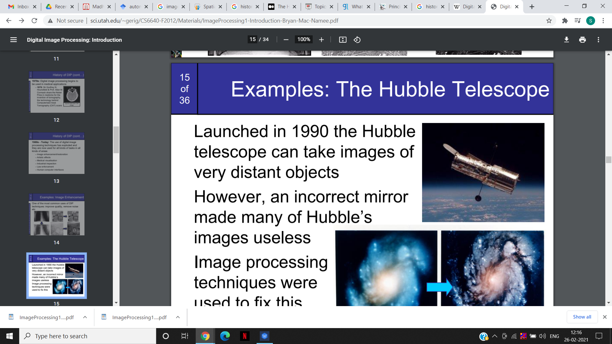
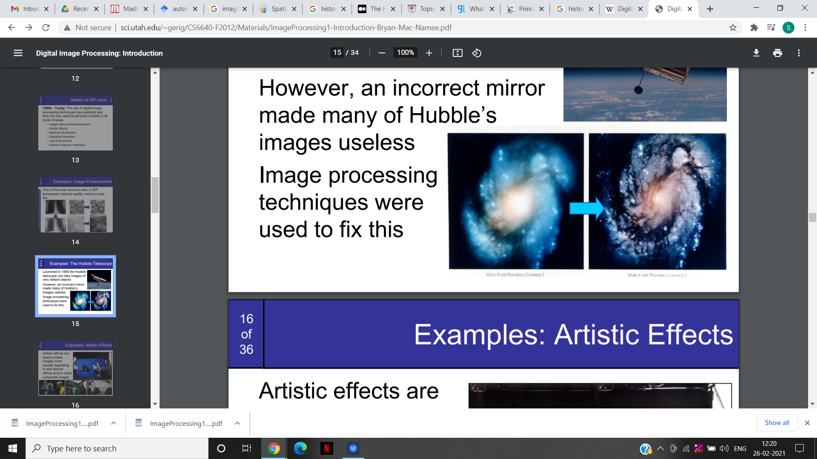
The Hubble Telescope
Launched in 1990 the Hubble
telescope can take images of
very distant objects
However, an incorrect mirror
made many of Hubble’s
images useless
Image processing
techniques were
used to fix this

Slide 9
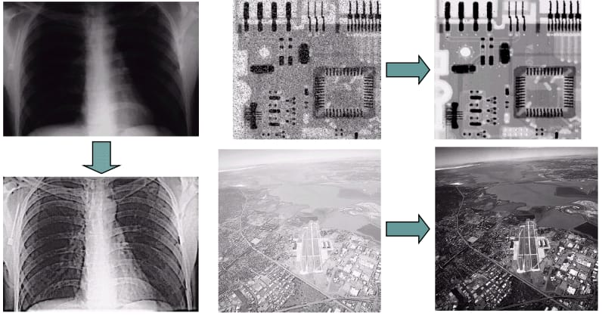
Examples: Image Enhancement
One of the most common uses of DIP techniques: improve quality, remove noise, etc.

Slide 10
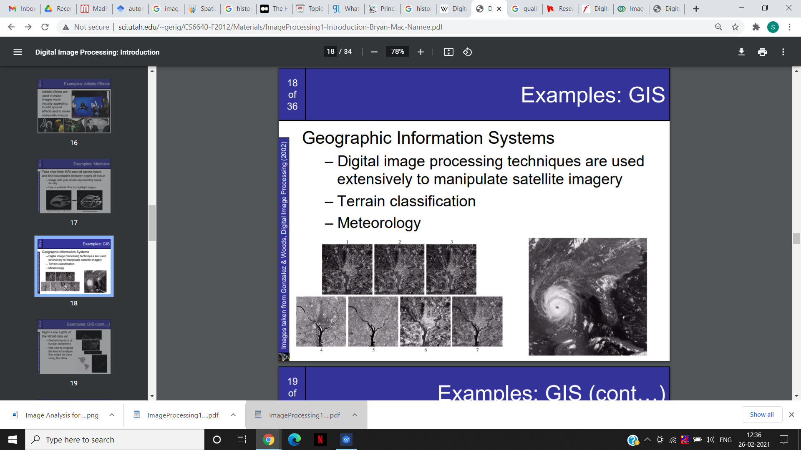
Applications of DIP
1)Geographic Information Systems
– Digital image processing techniques are used
extensively to manipulate
satellite imagery
– Terrain classification
– Meteorology

Slide 11
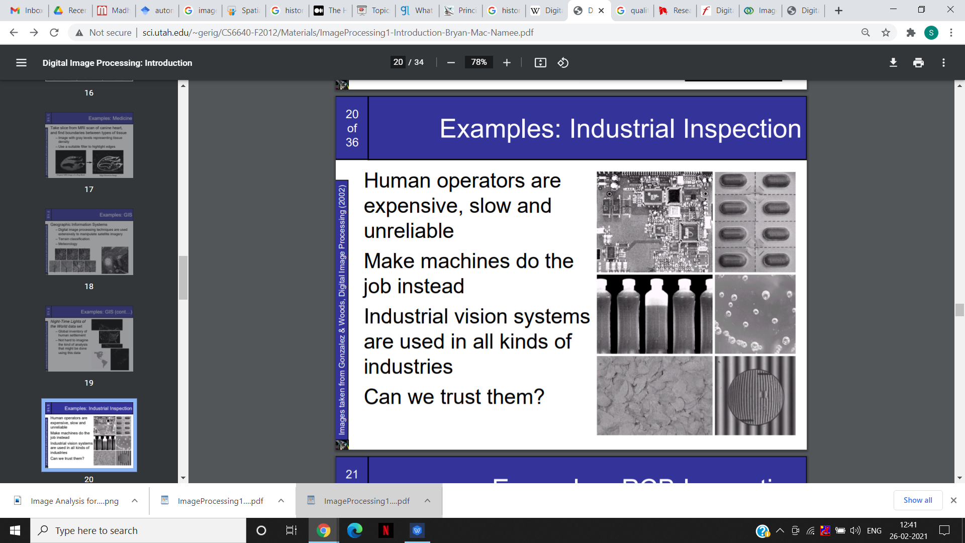
Examples: Industrial Inspection
Human operators are expensive, slow and unreliable
Make machines do the
job instead
Industrial vision systems
are used in all kinds of
industries
Can we trust them?

Slide 12
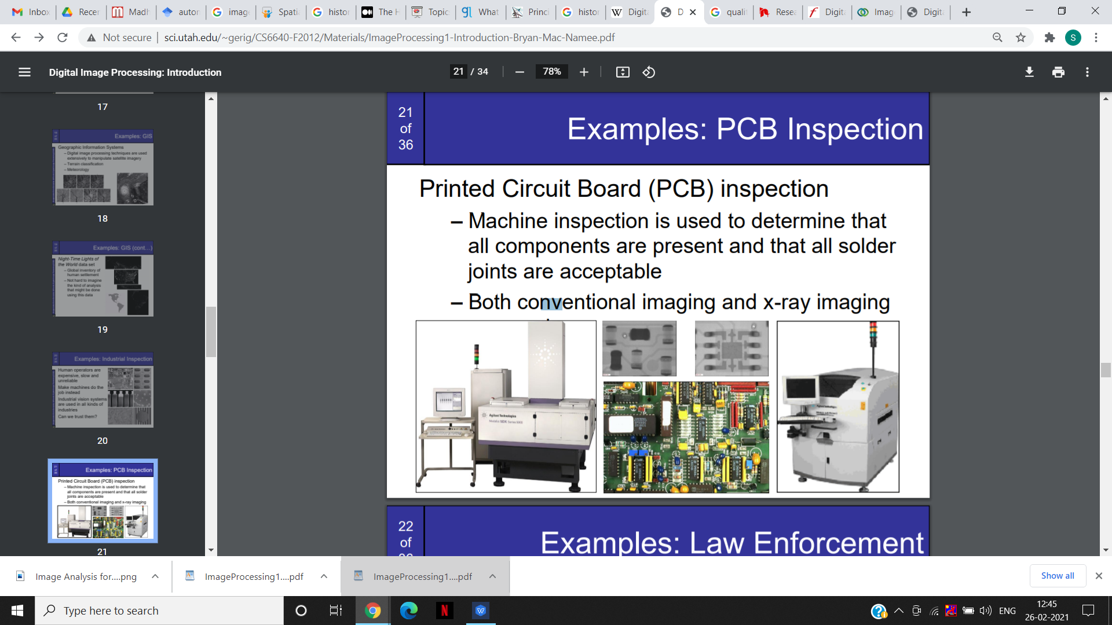
Examples: PCB Inspection
Printed Circuit Board (PCB) inspection
Machine inspection is used to determine that all components are present and that all solder joints are acceptable
Both conventional imaging and x-ray imaging

Slide 13
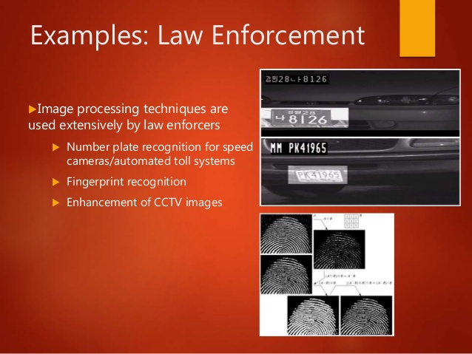
Examples: Law Enforcement
Image processing techniques are used extensively by law enforcers 
Number plate recognition for speed cameras/automated toll systems 
Fingerprint recognition 
Enhancement of CCTV images

Slide 14
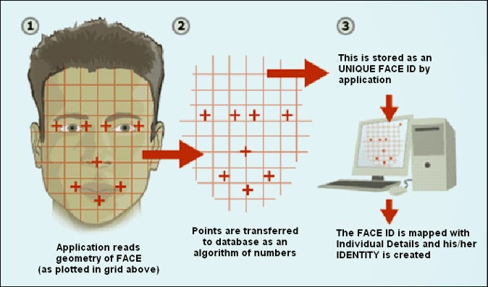
Examples: HCI
Try to make human computer interfaces more natural.
- Face recognition
- Gesture recognition
Does anyone remember the user interface from “Minority Report”?
These tasks can be extremely difficult.

Slide 15
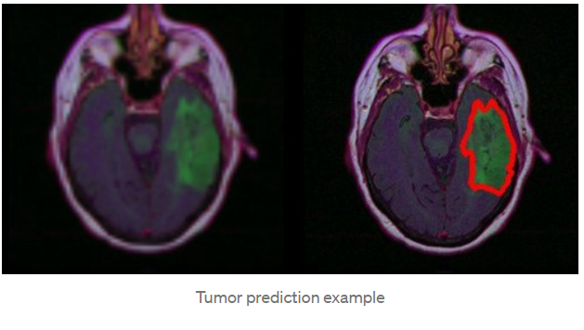
Examples: Medical Applications
A tumor can be defined as any mass caused by abnormal or uncontrolled growth of cells.
Brain tumor extraction and its analysis are challenging tasks in Medical image processing because brain image is complicated.
Segmentation plays a very important role in the medical image processing.

Slide 16
CONCLUSION
In electrical engineering and computer science, imageprocessing is any form of signal processing for which the input is an image, such as photographs or frames of video;the output of image processing can be either an image or aset of characteristics or parameters related to the image.Most image-processing techniques involve treating the image as a two-dimensional signal and applying standardsignal-processing techniques to it.
In most cases, effective use of color space – face color relationships and morphological processing allowed effective pre-processing.
For images trained on, able to detect faces with reasonable accuracy and miss and false alarm rates.
Adaptive adjustment of template scale, angle, and threshold allowed most faces to be detected.

Slide 17
Thank You

